Slide 1

ACCIDENT ALERT AND VEHICLE TRACKING SYSTEM USING ARDUINO
GUIDED BY
Mr T. V. A. BHANUPRAKASH SIR,
SUBMITTED BY
R.BALAJI 17JE1A0417
P.KANTHI 17JE1A0413
P.SASIKUMAR 17JE1A0415
C.CHENNAKESAVULU 17JE1A0403

Slide 2
CONTENTS
ABSTRACT
INTRODUCTION
EXISTING SYSTEM
PROPOSED SYSTEM
BLOCK DIAGRAM
WORKING
ADVANTAGES
DRAWBACKS
TECHNICAL SPECIFICATIONS
SOFTWARE
INITIAL STATUS
GPS AND GSM ACTIVATED
APPLICATIONS
REFERENCES

Slide 3
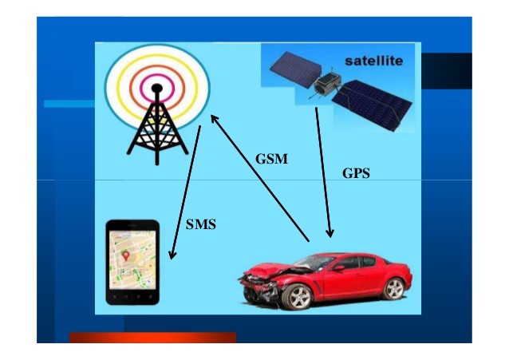
ABSTRACT
Arduino Based Vehicle Accident Alert System using GPS, GSM and Accelerometer.
Accelerometer detects the sudden change in the axes of vehicle and GSM module send the alert message on your Mobile Phone with the location of the accident.
Location of accident is sent in the form of Google map link, derived from the latitude and longitude from GPS module.
There are 2 switches present
SOS- Switch
Reset-Switch
SOS Switch triggers the buzzer if the person is feeling sick.
Reset Switch is also provided terminate the sending message in rare cases where there is no casualty ,this can save the time of the ambulance.

Slide 4

INTRODUCTION
The main intention of this project is to find the accident spot at any place and intimating it to ambulance through the GPS and GSM
The GPS based vehicle accident identification module contains MEMS,GSM module and GPS module connected to Arduino board
Now a days ,it became very difficult to know that an accident has occurred and to locate the position where it has occurs
GSM technology is used to establish cellular communication and
GPS is used to trace the position of the vehicle
There is no system of identification and intimation regarding an accident in previous
Later on the SMS service begins for intimation purpose

Slide 5
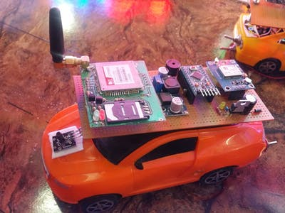
EXISTING SYSTEM
Majorly it is common scenario that people die in unnoticed accidents, especially at night time.
Communication is possible only through telephone calls .
There is system to inform the rescue forces when the accident occurs.
Every day around the world ,a large number of people die from an accident
At once an accident happened we did not find the exact location of the place

Slide 6
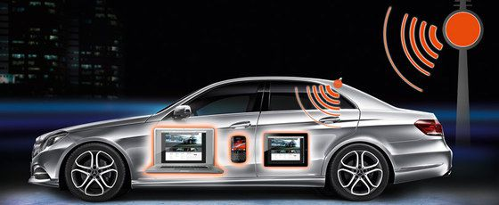
PROPOSED SYSTEM
This project presents an automotive localization system using GPS and GSM services

Slide 7
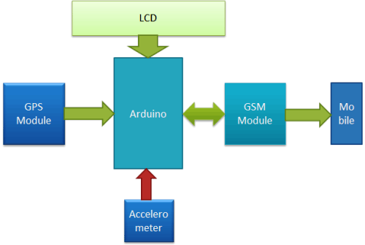
BLOCK DIAGRAM

Slide 8
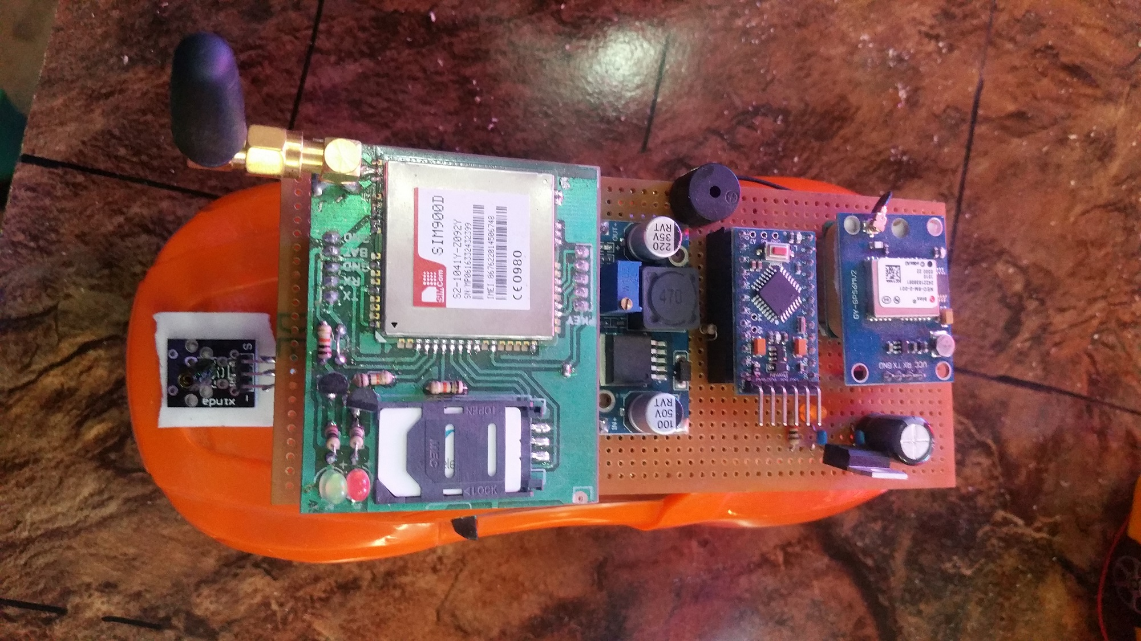
WORKING :-
Arduino is used as main microcontroller and this system is made for an accident alert
The whole system is implemented in vehicle itself
Whenever an accident occurs, the sudden changes in axes(x ,y ,z ) of the accelerometer ADXL335, it senses an over all impact and used to detect possibility of accident.
Arduino sends the signal to GPS ne06m, it detects the location of the accident.
Alert message is sent to through the GSM network using SIM900A
Emergency message is received on the mobile number which is given in the program
Modules and other parts of system are centrally controlled from Arduino Uno.
It is connected to 8v battery

Slide 9
ADVANTAGES
Automatic alert on vehicle accident
Immediate help can be provided
Accident rate can be reduced
Accident tracking technology can be used with out delay

Slide 10
DRAW BACKS
Less global networking
Hardware and software failure
Informed after the accident occurs
No safety for driver and passengers

Slide 11
TECHNICAL SPECIFICATION
Hardware:
Arduino UNO
GPS module
GSM module
Vibration sensor
Alarm module
Accelerometer
Liquid crystal display(LCD)

Slide 12
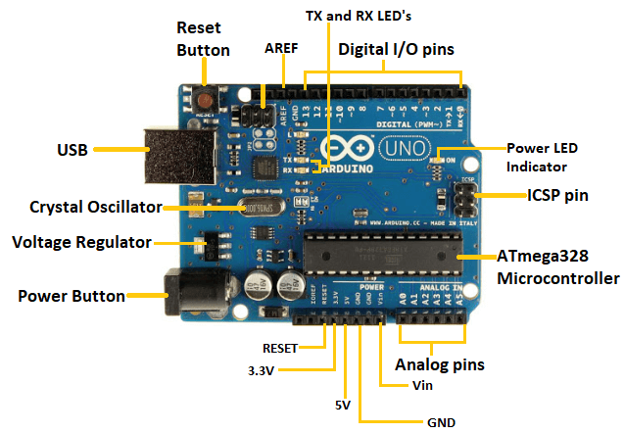
ARDUINO UNO
Arduino – software
Uno-one
Microcontroller-ATmega328p
14 digital I /o pins
6 analog I /o pins
The microcontroller simply connect to a computer with a USB cable to get started.

Slide 13
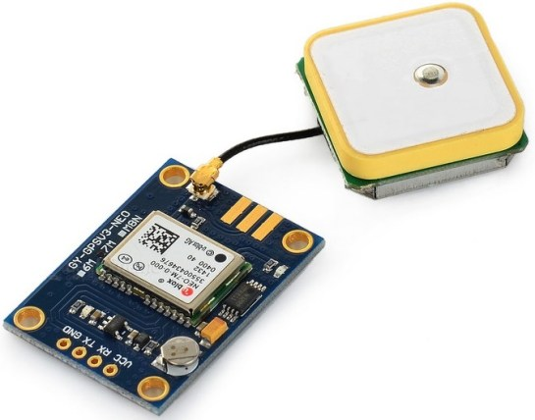
GPS MODULE
GPS – global positioning system
It detects latitude and longitude of any location with exact UTC(universal time coordinated) time
This device receives the coordinates from the satellite for each and every second, with time and date.
GPS module is used to track the location of an accident in our project

Slide 14
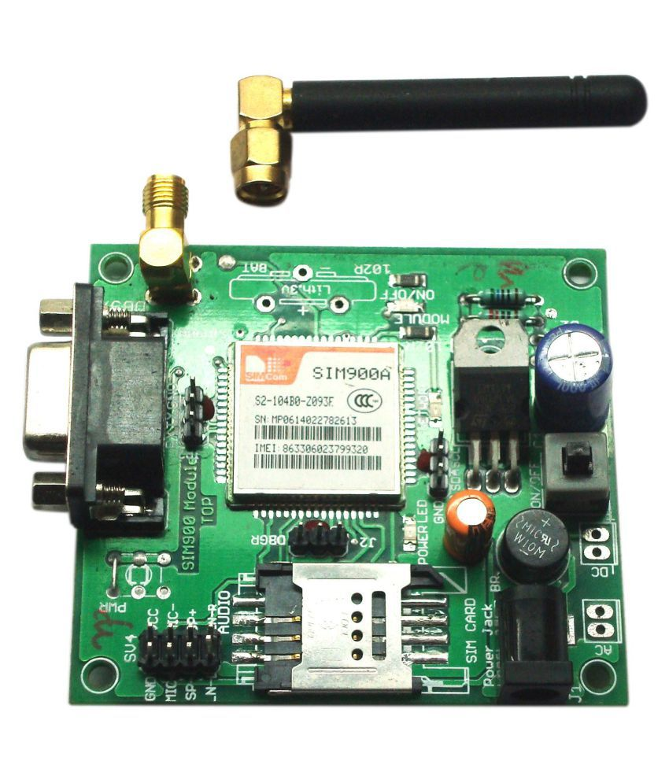
GSM MODULE
GSM- global system for mobile communication
It is a wireless cellular communication technique used for public communication
SIM900 GSM module is preferred for this project for communication between accident detector and alert system and mobile phone
It is basically tri-band work on various frequency range(EGSM 900MHZDSC1800 MHZandPCS1900MHZ)
In order to make communication between GSM and Arduino uno we Rx pin of GSM module and Tx pin of Arduino

Slide 15
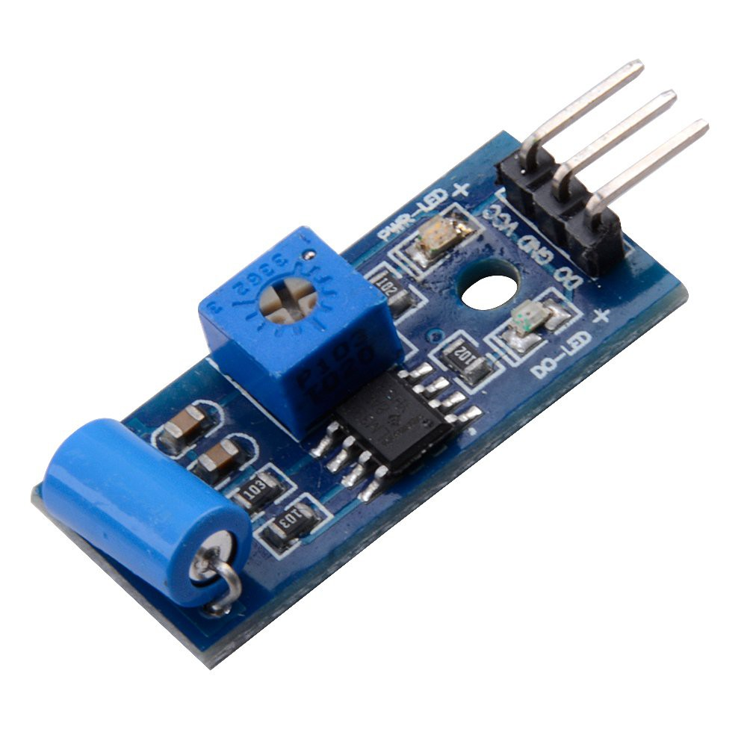
VIBRATION SENSOR
Vibration is most commonly measured by accelerometer
This sensor uses the piezoelectric effects while measuring the changes with in acceleration ,pressure ,temperature etc.
It is also called a piezoelectric sensor

Slide 16
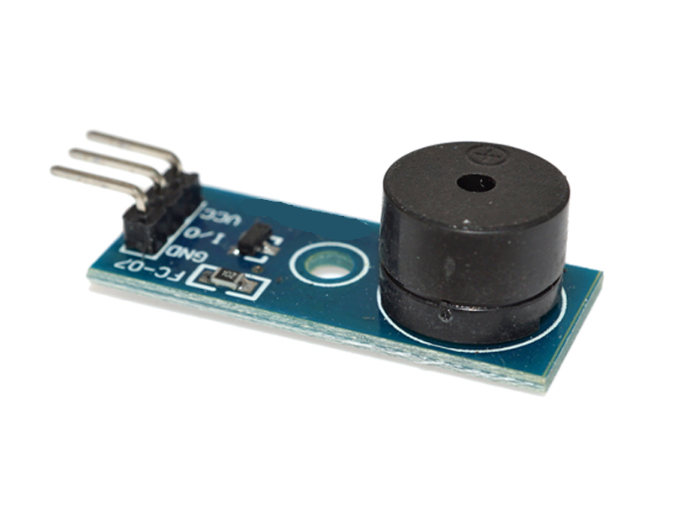
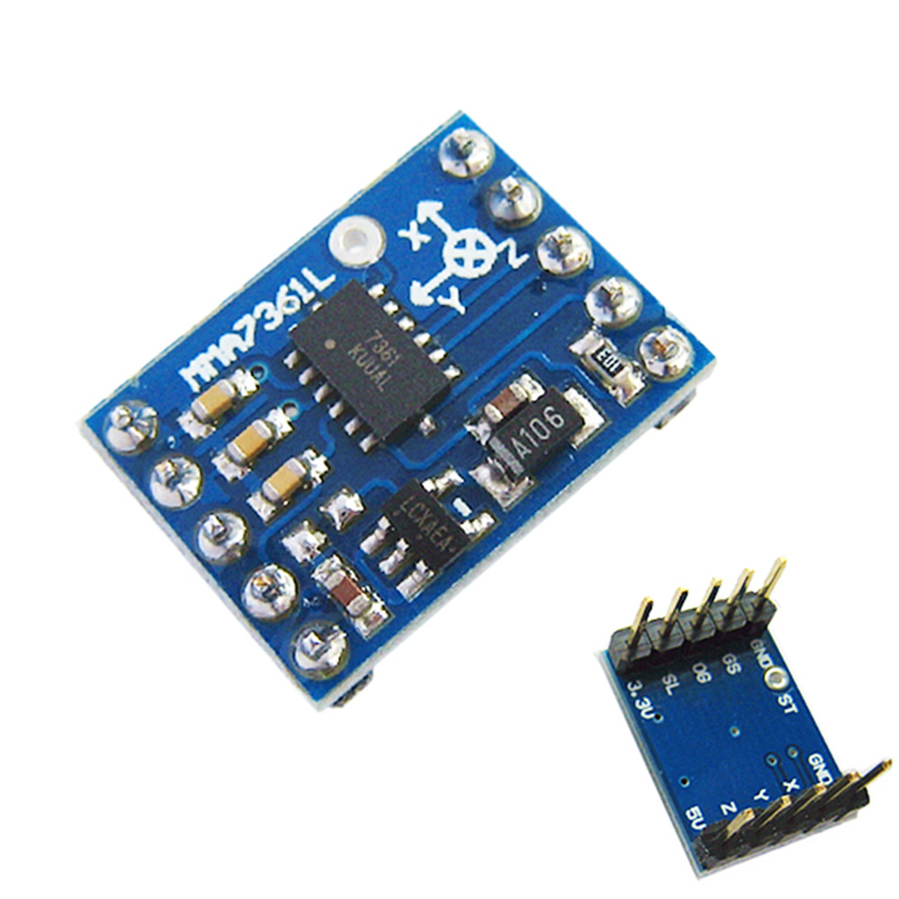
Alarm module and accelerometer
Alarm is a output module used for indication
Accelerometer is electromechanical device used for measure acceleration forces
Pin description of accelerometer:
Vcc -5v supply
X,Y,Z- OUT
GND
ST-sensitivity of sensor

Slide 17
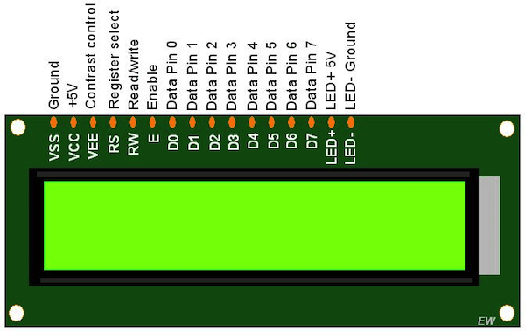
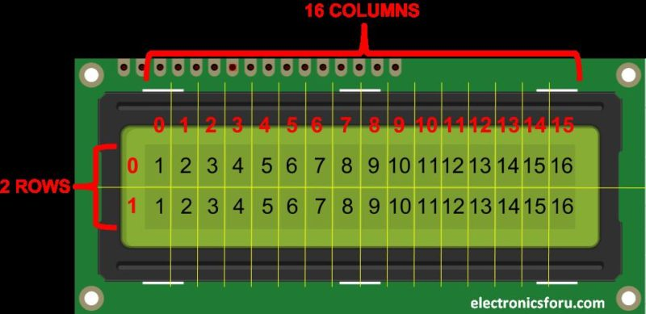
LCD
LCD – liquid crystal display
It has total 16 pins
It is used to display the output
It has two rows each one has 16 numbers
It has 16 columns

Slide 18
SOFTWARE:
Arduino IDE
Proteus

Slide 19
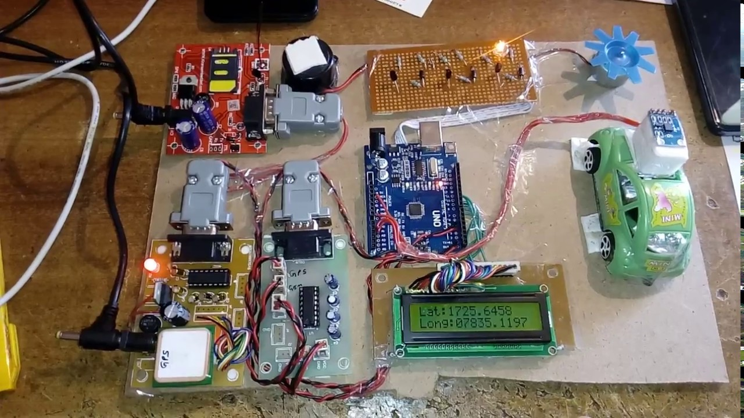
INITIAL STATUS

Slide 20
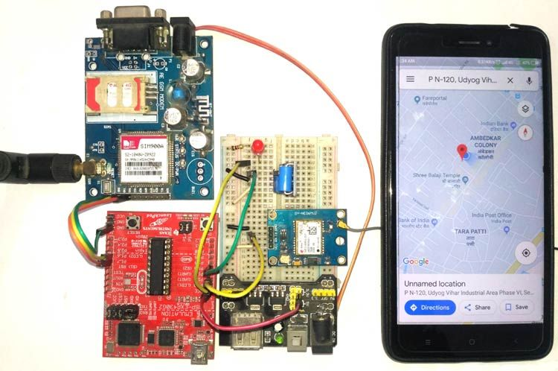
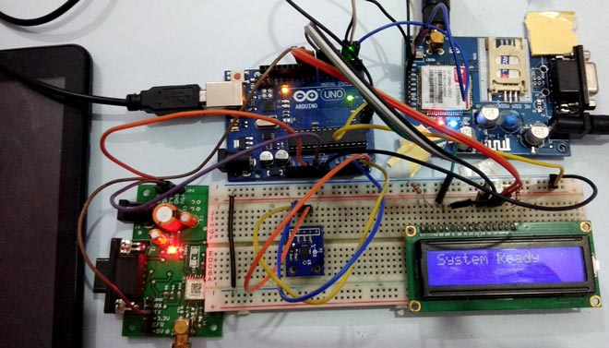
GPS AND GSM ACTIVATED

Slide 21
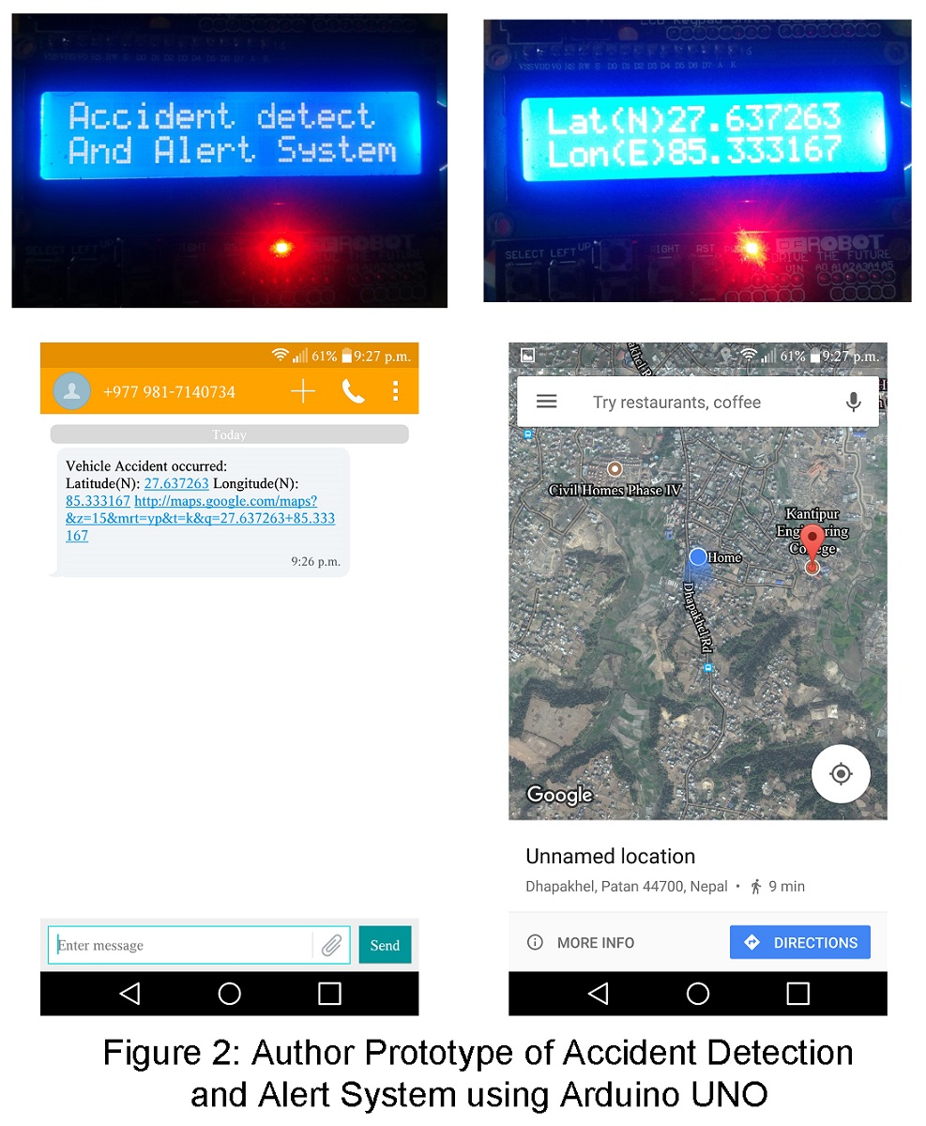
RESULT:-

Slide 22
APPLICATIONS
Auto motives
Auto mobiles

Slide 23
REFERENCES
http://www.arduino.cc/
http://www.Wikipedia.org/
http://studymafia.org/

Slide 24


Slide 25


